Slide 1


Chapter 6: IUS for clinical management of CD
v1.0, 10 December 2022 | EM-121011
For Healthcare Professionals only
Developed under the mentorship of the Asian Organization for Crohn's & Colitis
Supported by Janssen Asia Pacific, a division of Johnson and Johnson International (Singapore) Pte. Ltd. Editorial development by Transform Medical Communications, New Zealand
© Janssen Asia Pacific, a division of Johnson & Johnson International (Singapore) Pte. Ltd.
CD: Crohn’s disease; IUS: Intestinal ultrasound

Slide 2
About IUS Primer module
IUS Primer module was created for training gastroenterologists in Asia on adopting Intestinal Ultrasound (IUS) for the diagnosis and management of Inflammatory Bowel Disease
Transform Medical Communications was commissioned by Janssen Asia Pacific for the development of this educational module under the guidance of IUS Primer working group members and AOCC. The division of Janssen responsible for developing the module is from medical education that follows strict non-promotional and educational guidance.
The development of the module was funded by Janssen Asia Pacific, a division of Johnson and Johnson International (Singapore) Pte. Ltd. in 2022. Non-commercial use of this module is permitted without any further permission, provided credit for the content is clearly attributed to Janssen Asia Pacific.
AOCC: Asian Organization for Crohn's & Colitis; IUS: Intestinal ultrasound.

Slide 3
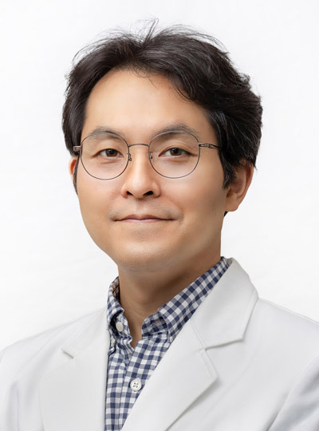
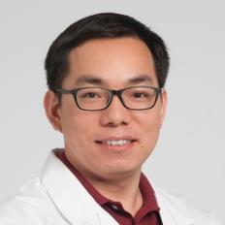
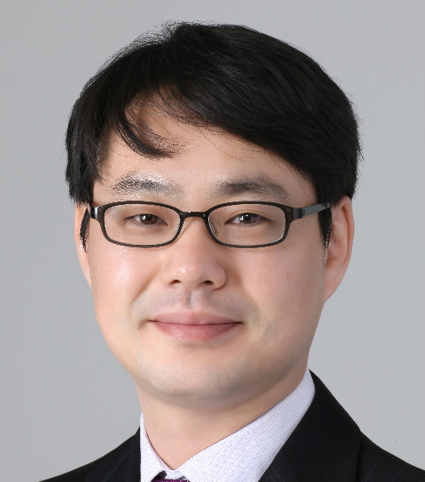

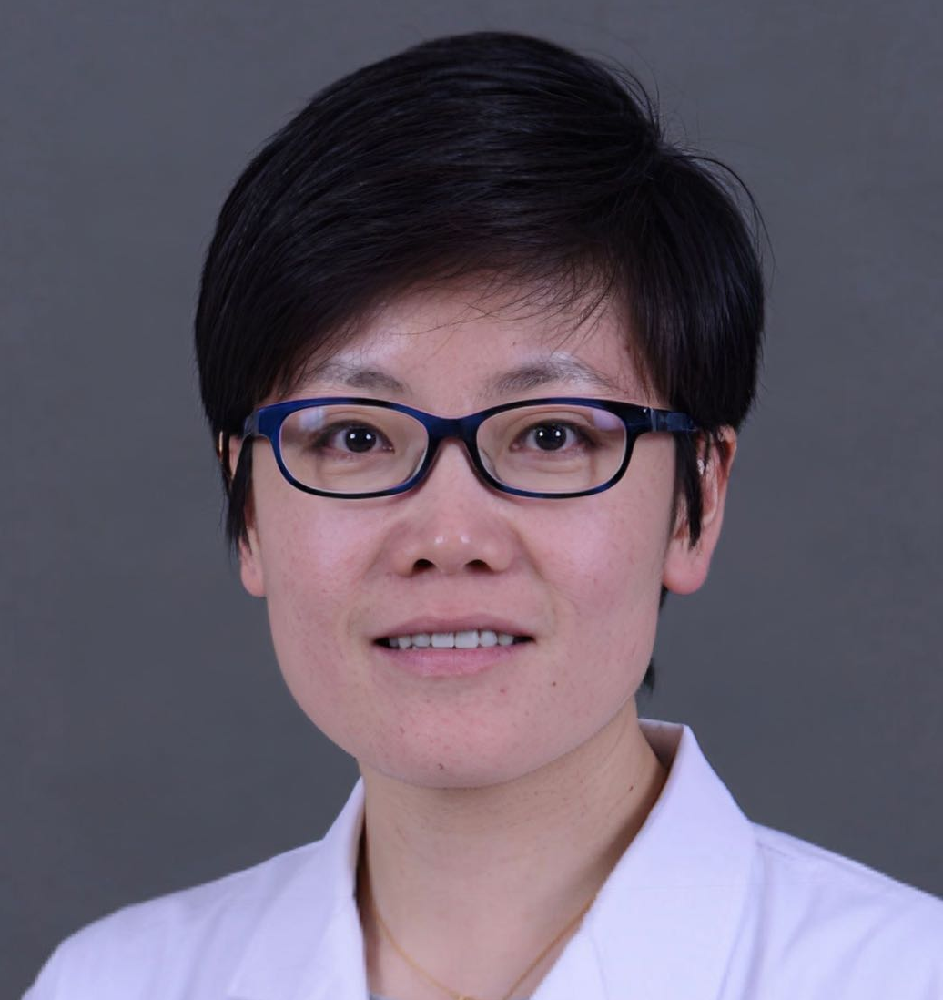


Special thanks to IUS Primer AOCC working group members
Prof. Eun Soo KIM
A/Prof. Ren MAO
Kyungpook National University
First Affiliated Hospital of Sun Yat-sen University
KOREA
CHINA
Prof. Chang Kyun LEE
A/Prof. Jun MIYOSHI
Kyung Hee University
Kyorin University
KOREA
JAPAN
Prof. Yue LI
Dr. Shintaro SAGAMI
Peking Union Medical College Hospital
Kitasato University Kitasato Institute Hospital
CHINA
JAPAN
AOCC: Asian Organization for Crohn's & Colitis; IUS: Intestinal ultrasound; WG: working group.

Slide 4
Learning Objectives
Learn the role of IUS for diagnosis and clinical management of CD
Explore the correlation of IUS findings in CD with endoscopic disease activity
Understand the IUS scoring system for CD
1
2
3
CD: Crohn’s disease; IBD: inflammatory bowel disease; IUS: Intestinal ultrasound; WG: working group

Slide 5




Role of IUS in management of Crohn’s disease
Many scores were developed to assess CD with IUS, without an international agreement. One of the most accurate and internationally validated scoring systems is the International Bowel Ultrasound Segmental Activity Score (IBUS-SAS).¹
The role of IUS in diagnosing and monitoring CD evolution is well established.^{1,2}
Studies have shown that IUS can be used for diagnosing CD, identifying disease extension, severity, complications, as well as response to treatment.¹
Bowel wall thickness, stratification, colonic wall flow on doppler, and fatty wrapping are accessible features to IUS that are correlated with CD disease levels.^{1,2}
IUS: intestinal ultrasound; CD: Crohn’s disease.
1. Frias-Gomes, C. (2021). GE Portuguese journal of gastroenterology, 29(4), 223–239. 2. Stenczel, N. D. (2021). Journal of medicine and life, 14(3), 310–315.
Notes:
Frias-Gomes, C., Torres, J., & Palmela, C. (2021). Intestinal Ultrasound in Inflammatory Bowel Disease: A Valuable and Increasingly Important Tool. GE Portuguese journal of gastroenterology, 29(4), 223–239. https://doi.org/10.1159/000520212
Stenczel, N. D., Purcarea, M. R., Tribus, L. C., & Oniga, G. H. (2021). The role of the intestinal ultrasound in Crohn's disease diagnosis and monitoring. Journal of medicine and life, 14(3), 310–315. https://doi.org/10.25122/jml-2021-0067

Slide 6
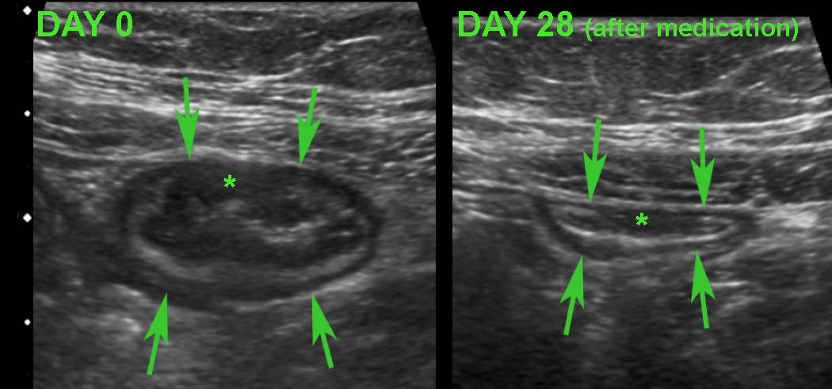
IUS for monitoring short-term response to treatment in CD
IUS images of the terminal ileum in a patient with CD after 28 days of treatment
Note a prominent decrease in BWT (arrows) after therapy.
Transmural changes (subtle hypoechoic area shown with green *) are still visible near the wall after 28 days of treatment.
Image credit: Zijta, F., Vanhooymissen I & Puylaert J, Radiology Assistant website. Reproduced with permission from the Radiology Assistant website, strictly for educational purposes only.
IUS: intestinal ultrasound; CD: Crohn’s disease; BWT: bowel wall thickness.
Zijta, F., Vanhooymissen, I. & Puylaert, J. Crohn's disease - role of Ultrasound. Radiology Assistant. Available at: https://radiologyassistant.nl/abdomen/bowel/ultrasound-in-crohns-disease

Slide 7
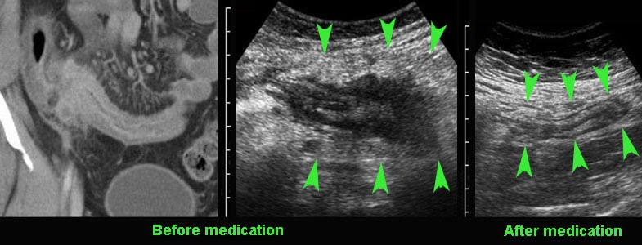
Example of IUS long-term monitoring of CD in the terminal ileum
IUS images of the terminal ileum in a patient with CD after 8 months of treatment
Before medication
After medication
Note that the BWT and the acutely inflamed fat around the ileum decreased after treatment (green arrowheads).
Image credit: Zijta, F., Vanhooymissen I & Puylaert J, Radiology Assistant website. Reproduced with permission from the Radiology Assistant website, strictly for educational purposes only.
IUS: intestinal ultrasound; CD: Crohn’s disease; BWT: bowel wall thickness.
Zijta, F., Vanhooymissen, I. & Puylaert, J. Crohn's disease - role of Ultrasound. Radiology Assistant. Available at: https://radiologyassistant.nl/abdomen/bowel/ultrasound-in-crohns-disease

Slide 8
Crohn colitis vs ulcerative colitis
On clinical grounds and even with the help of endoscopy and biopsies, it can sometimes be difficult to differentiate Crohn’s colitis from UC.
Differentiating ulcerative colitis from Crohn’s colitis with IUS
Demonstration of hypoechoic, transmural inflammation (shown as green * in the image on the left) and the presence of non-compressible inflamed fat^ strongly favour CD
^In severe UC, there may be increased echogenicity of the surrounding fat. This fat is rather well-compressible and should be considered as oedema associated with secondary hyperemia rather than as a sign of true transmural inflammation.
Image credit: Zijta, F., Vanhooymissen I & Puylaert J, Radiology Assistant website. Reproduced with permission from the Radiology Assistant website, strictly for educational purposes only.
IUS: intestinal ultrasound; CD: Crohn’s disease; UC: ulcerative colitis
Zijta, F., Vanhooymissen, I. & Puylaert, J. Crohn's disease - role of Ultrasound. Radiology Assistant. Available at: https://radiologyassistant.nl/abdomen/bowel/ultrasound-in-crohns-disease

Slide 9
Appendiceal involvement in ileocecal CD on IUS
Normal (A) and different variations (B-D) of appendiceal involvement in ileocecal CD on IUS
In most patients with ileocecal CD the appendix (green arrow) is normal (image A), or only minimally reactively thickened (image B).
In some patients (image C) with ileocecal CD, slight transmural changes in the appendix submucosa (shown as*) indicate Crohn’s involvement in the appendix.
In image ‘D’, there is severe involvement of the ileum, cecum and appendix (green arrow), with abundant surrounding inflamed fat.
Image credit: Zijta, F., Vanhooymissen I & Puylaert J, Radiology Assistant website. Reproduced with permission from the Radiology Assistant website, strictly for educational purposes only.
IUS: intestinal ultrasound; CD: Crohn’s disease.
Zijta, F., Vanhooymissen, I. & Puylaert, J. Crohn's disease - role of Ultrasound. Radiology Assistant. Available at: https://radiologyassistant.nl/abdomen/bowel/ultrasound-in-crohns-disease

Slide 10
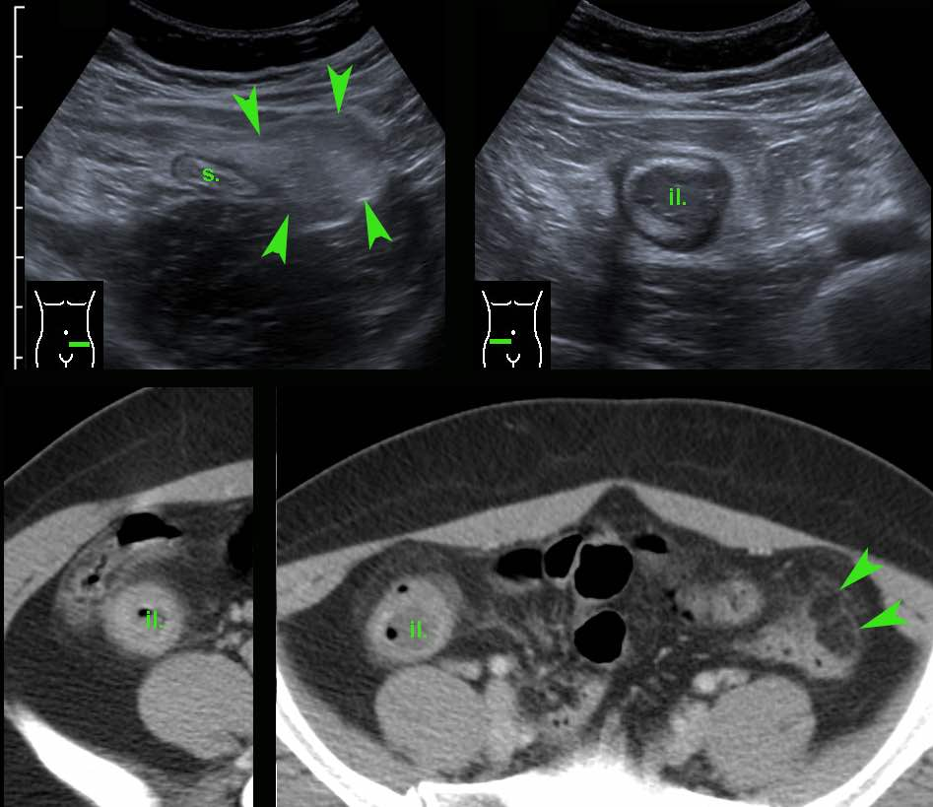
Crohn’s ileitis on IUS and CT scan
Abnormal terminal ileum (il.) in a patient with CD.
Image credit: Zijta, F., Vanhooymissen I & Puylaert J, Radiology Assistant website. Reproduced with permission from the Radiology Assistant website, strictly for educational purposes only.
CT confirmed Crohn’s ileitis, in the same patient.
The small green arrowheads reflect left-sided epiploic appendagitis (unrelated to CD)
IUS: intestinal ultrasound; CD: Crohn’s disease; CT: computed tomography
Zijta, F., Vanhooymissen, I. & Puylaert, J. Crohn's disease - role of Ultrasound. Radiology Assistant. Available at: https://radiologyassistant.nl/abdomen/bowel/ultrasound-in-crohns-disease

Slide 11
IBUS-SAS – an international score for IUS monitoring in CD*
11 experts from 9 countries participated in establishing an IUS score for identifying active disease in CD patients.
Out of 12 parameters, 4 were identified as the most relevant elements to develop the score: BTW, bowel wall flow (color doppler signal), mesenteric fat, and bowel wall stratification.
 | Normal | Uncertain | Active
BWT | ≤ 3mm | N/A | > 3mm
Mesenteric fat | 0 = absent | 1 = uncertain | 2 = present
Bowel wall flow (color doppler) | 0 = absent | 1 = uncertain | 2 = long signal inside bowel | 3 = long signal inside & outside bowel
Bowel wall stratification | 0 = normal | 1 = uncertain | 2 = focal (≤3cm) | 3 = extensive (>3cm)
*Mainly used for research.
IBUS-SAS: International Bowel Ultrasound Segmental Activity Score; IUS: intestinal ultrasound; CD: Crohn’s disease; BTW: bowel wall thickness.
Novak, K. L. (2021). Journal of Crohn's & colitis, 15(4), 609–616.
Notes:
Novak, K. L., Nylund, K., Maaser, C., Petersen, F., Kucharzik, T., Lu, C., Allocca, M., Maconi, G., de Voogd, F., Christensen, B., Vaughan, R., Palmela, C., Carter, D., & Wilkens, R. (2021). Expert Consensus on Optimal Acquisition and Development of the International Bowel Ultrasound Segmental Activity Score [IBUS-SAS]: A Reliability and Inter-rater Variability Study on Intestinal Ultrasonography in Crohn's Disease. Journal of Crohn's & colitis, 15(4), 609–616. https://doi.org/10.1093/ecco-jcc/jjaa216

Slide 12
Calculation and interpretation of IBUS-SAS for IUS monitoring of CD
IBUS-SAS = (4 x BWT) + (15 x mesenteric fat score) + (7 x bowel wall flow score) + (4 x BWS score)
IBUS-SAS ranges from 0 to 100
0: no or inactive disease
100: Theoretical worse ever disease
IBUS-SAS presented almost perfect reliability with an intraclass correlation coefficient = 0.97 (1 is perfect)
*Mainly used for research.
IBUS-SAS: International Bowel Ultrasound Segmental Activity Score; IUS: intestinal ultrasound; CD: Crohn’s disease; BTW: bowel wall thickness; BWS: Bowel wall stratification.
Novak, K. L. (2021). Journal of Crohn's & colitis, 15(4), 609–616.
Notes:
Novak, K. L., Nylund, K., Maaser, C., Petersen, F., Kucharzik, T., Lu, C., Allocca, M., Maconi, G., de Voogd, F., Christensen, B., Vaughan, R., Palmela, C., Carter, D., & Wilkens, R. (2021). Expert Consensus on Optimal Acquisition and Development of the International Bowel Ultrasound Segmental Activity Score [IBUS-SAS]: A Reliability and Inter-rater Variability Study on Intestinal Ultrasonography in Crohn's Disease. Journal of Crohn's & colitis, 15(4), 609–616. https://doi.org/10.1093/ecco-jcc/jjaa216

Slide 13
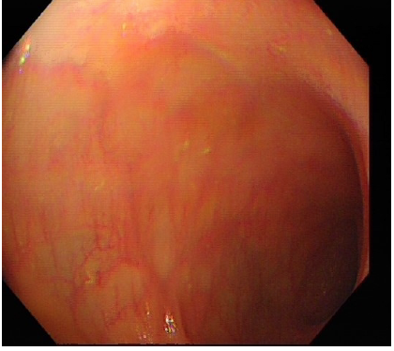
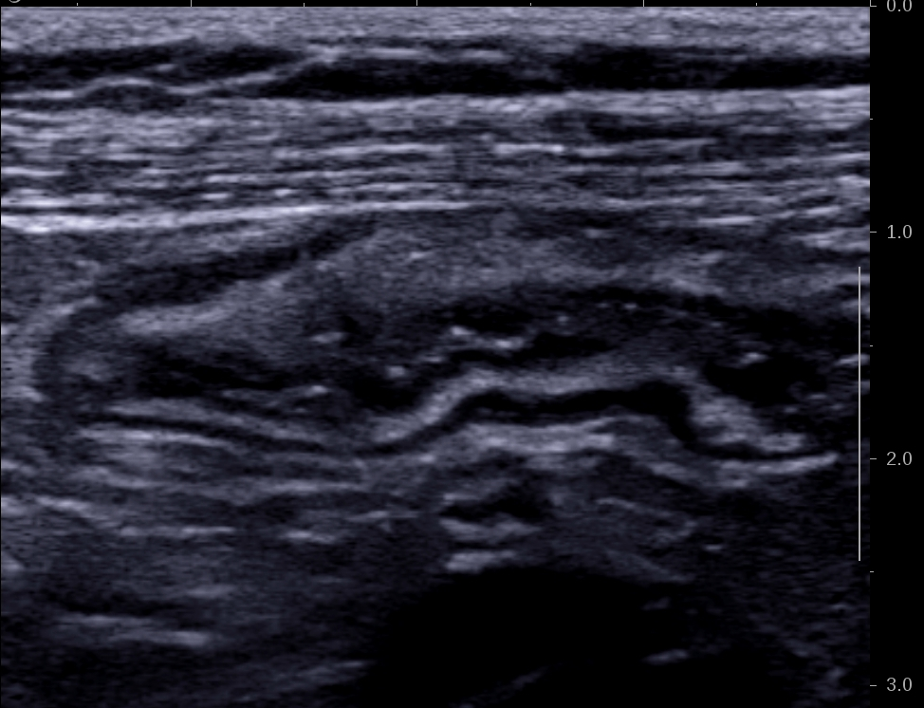
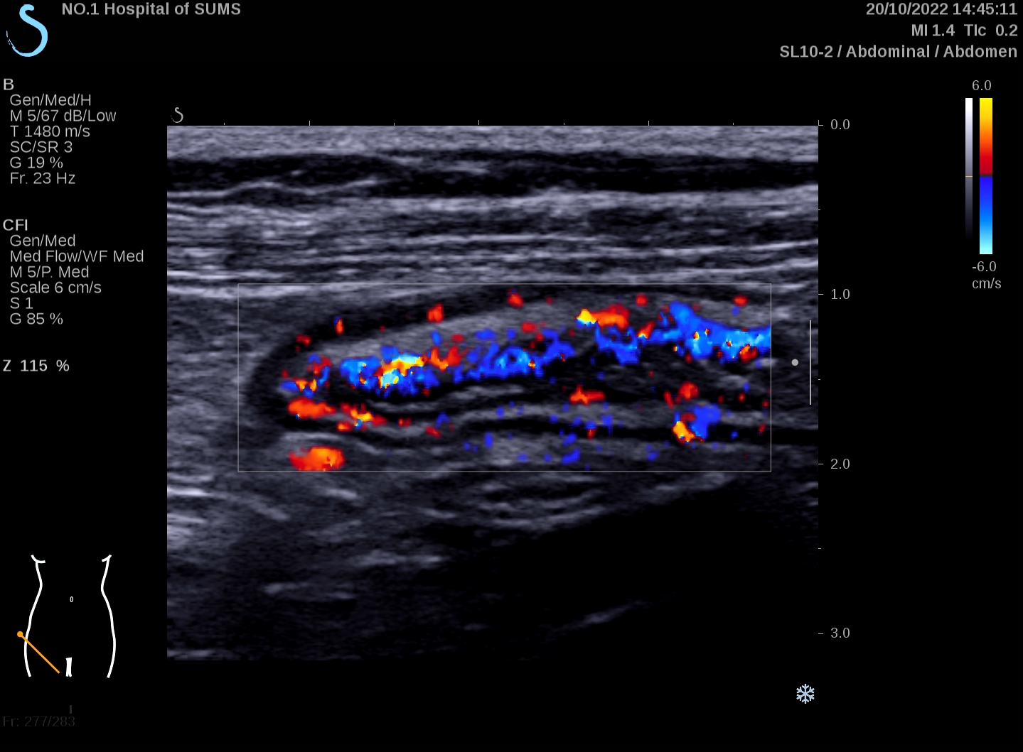
Comparing IUS and endoscopic findings in CD
‘Patient case A’ with non-stenotic non-penetrating ileocolonic CD
On endoscopy: scars and nodular hyperplasia in the mucosa of the ileocecal valve, ascending colon, transverse colon, and descending colon
On IUS: the thickest colonic wall was 4 mm, and the terminal ileum was 5 mm thick, with most thickening in the submucosa
On Doppler: Limberg class IV
All photos kindly provided by A/Prof. Ren Mao, First Affiliated Hospital of Sun Yat-sen University, China
IUS: Intestinal ultrasound; CD: Crohn’s disease.

Slide 14
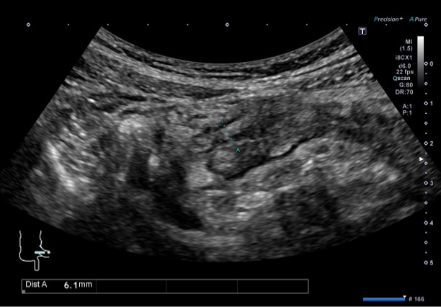
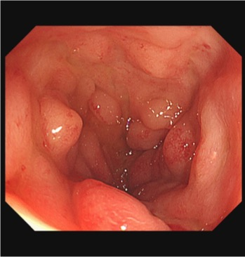
Comparing IUS and endoscopic findings for monitoring treatment response in CD
‘Patient case B’ with CD of terminal ileum: At baseline
Patient case B: IUS at baseline
Patient case B: endoscopy at baseline
Photo kindly provided by A/Prof. Jun Miyoshi, Kyorin University School of Medicine, Japan
Photo kindly provided by A/Prof. Jun Miyoshi, Kyorin University School of Medicine, Japan
Photo kindly provided by Prof. Jun Miyoshi, Kyorin University School of Medicine, Japan
IUS: Intestinal ultrasound; CD: Crohn’s disease.

Slide 15
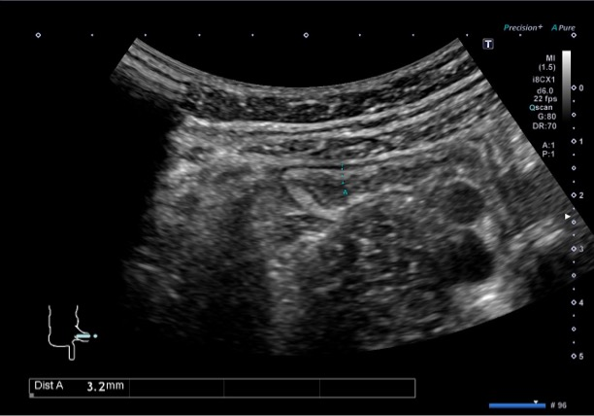
Comparing IUS and endoscopic findings for monitoring treatment response in CD (contd.)
‘Patient case B’ with CD of terminal ileum: At 3 months and 6 month post anti-TNF
Patient case B: IUS at 3 months post anti-TNF (improvement on IUS )
Patient case B: endoscopy at 6 months post anti-TNF
Photo kindly provided by A/Prof. Jun Miyoshi, Kyorin University School of Medicine, Japan
Photo kindly provided by A/Prof. Jun Miyoshi, Kyorin University School of Medicine, Japan
IUS: Intestinal ultrasound; CD: Crohn’s disease; TNF: Tumor necrosis factor..

